Slide 1

Generative Ai – Creating images
Anniina Sipria

Slide 2


Agenda
Simple Card Generator
- AWS Architecture
- APIs
- Demo

Slide 3


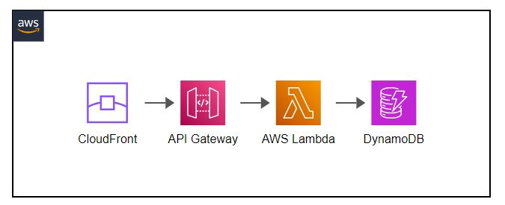
Simple Card Generator – AWS Architecture
- Serverless Land SAM Template https://serverlessland.com/patterns/cloudfront-apigw-rest-api-lambda-dynamodb-sam

Slide 4

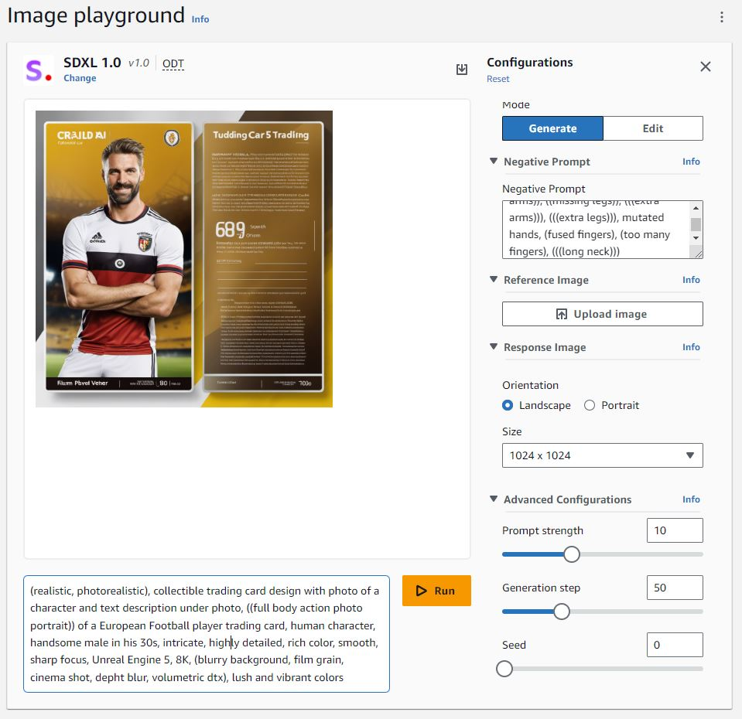
APIs
Amazon Bedrock
- Stability AI’s SDXL v. 1.0 and 0.8
- link to Amazon Bedrock
aws bedrock-runtime invoke-model \
--model-id stability.stable-diffusion-xl-v1 \
--body {"text_prompts":[{"text":“PROMPT","weight":1},{"text":“NEGATIVE PROMPT","weight":-1}], "cfg_scale":10,"seed":0,"steps":50,"width":1024,"height":1024} \
--cli-binary-format raw-in-base64-out \
--region us-east-1 \
invoke-model-output.txt

Slide 5


APIs
Amazon SageMaker Studio
- IDE for ML
- Prepare, Build, Train & Tune, Deploy & Manage
- https://docs.aws.amazon.com/sagemaker/latest/APIReference/API_runtime_InvokeEndpoint.html
Amazon SageMaker Studio lab
- Free service that gives customers access to AWS compute resources, in an environment based on open-source JupyterLab.
- https://studiolab.sagemaker.aws
{
"body": {
"text_prompts": [
{
"text": "jaguar in the Amazon rainforest"
}
]
},
"contentType": "application/json",
"endpointName": "jumpstart-dft-stabilityai-stable-di-20231214-115102",
"inferenceComponentName": "jumpstart-dft-stabilityai-stable-di-20231214-1-20231214-1151370"
}

Slide 6
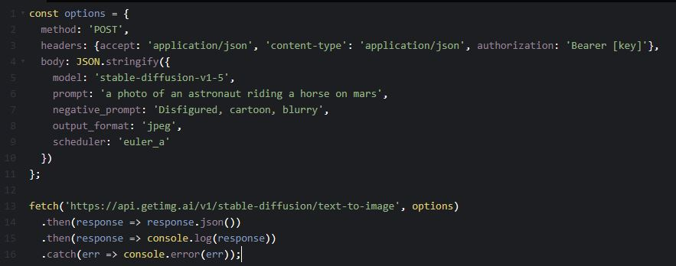
APIs
getimg.ai
- Simple to use: register > add credits > create API Key(s) > use
- Text to Image:
- link to the service

Slide 7
Demo time
! CLICK HERE !
Backup link . . .

Slide 8



Thank You!

